Slide 1
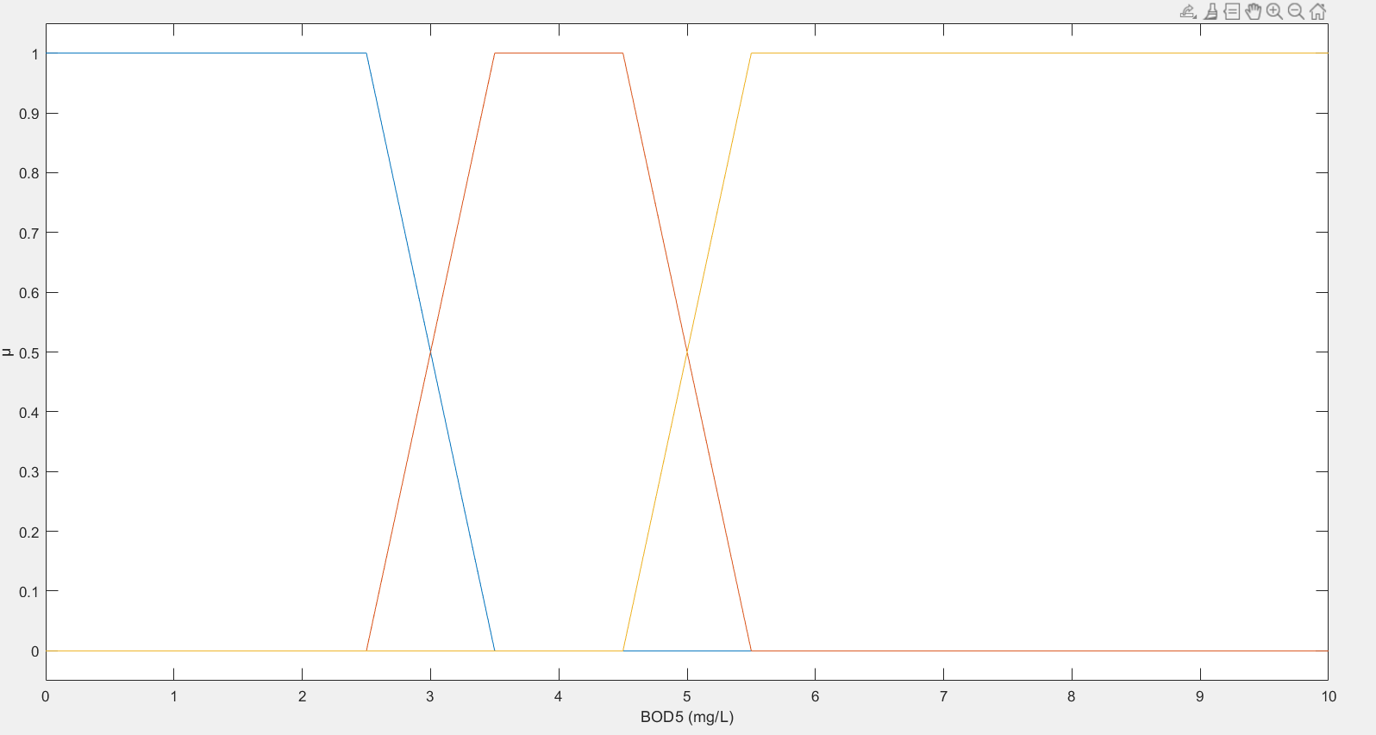
“LOW”
“MEDIUM”
“HIGH”

Slide 2
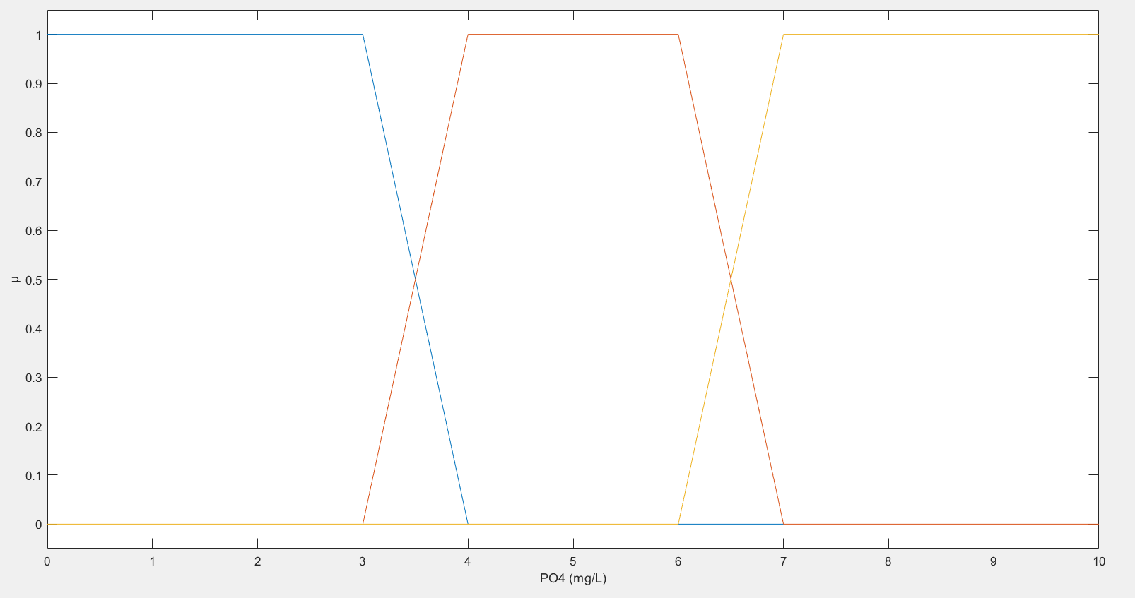
“LOW”
“MEDIUM”
“HIGH”

Slide 3
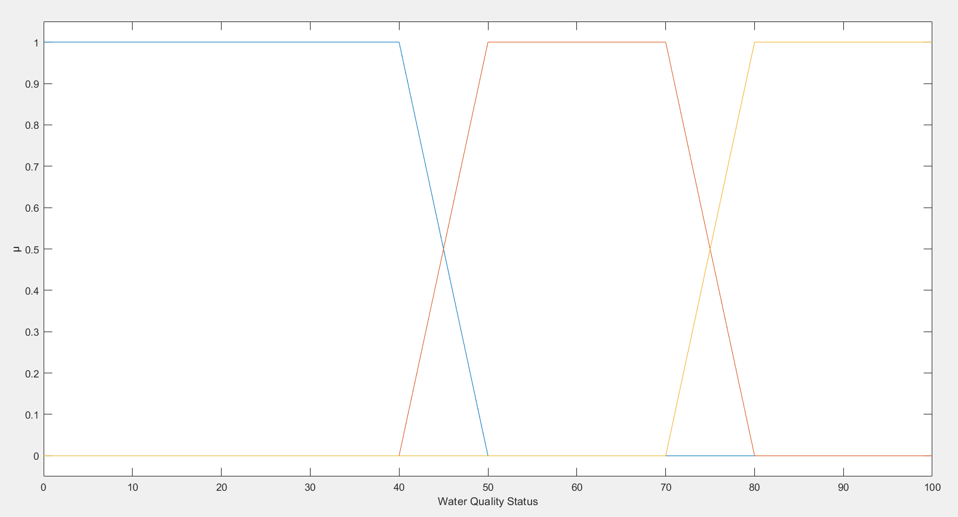
“POOR”
“AVERAGE”
“GOOD”

